Slide 1
The perceptron and large margin classifiers
Tine

Slide 2
Online learning
Online learning setting in which the algorithm has to make predictions continuously even while it’s learning.
In the online learning setting, we are interested in the total number of errors made by the algorithm during this process. Thus, it models applications in which the algorithm has to make predictions even while it’s still learning.

Slide 3
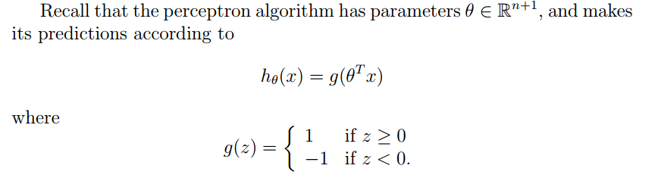

Slide 4
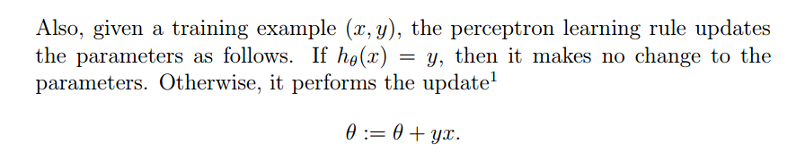

Slide 5
Bound
Note that the bound below on the number of errors does not have an explicit dependence on the number of examples m in the sequence, or on the dimension n of the inputs.

Slide 6
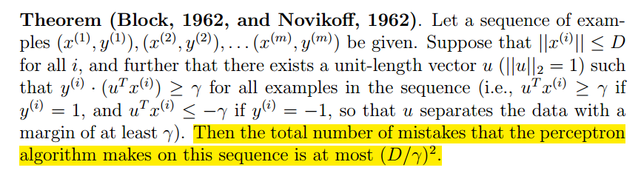

Theorem
因此感知器是一种收敛的算法，收敛上限${\left(\frac{D}{γ}\right)}^{2}$

Slide 7
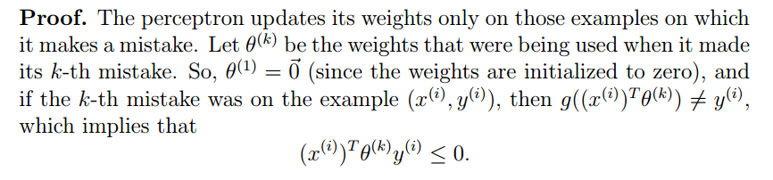
Proof

Slide 8
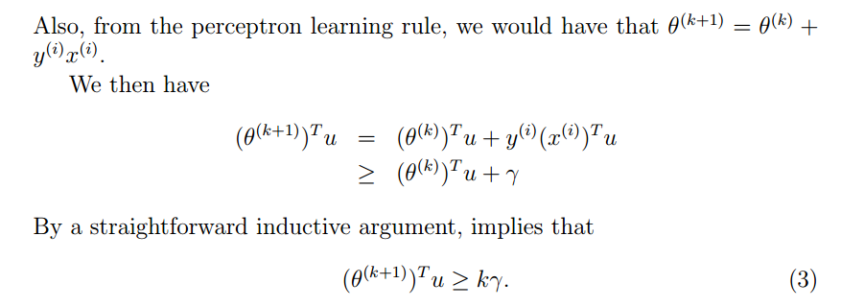

Slide 9
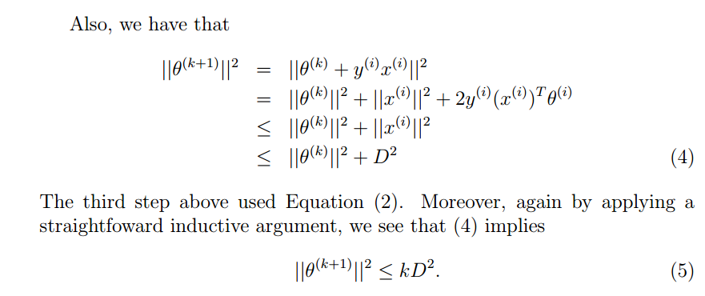

Slide 10
